Slide 1
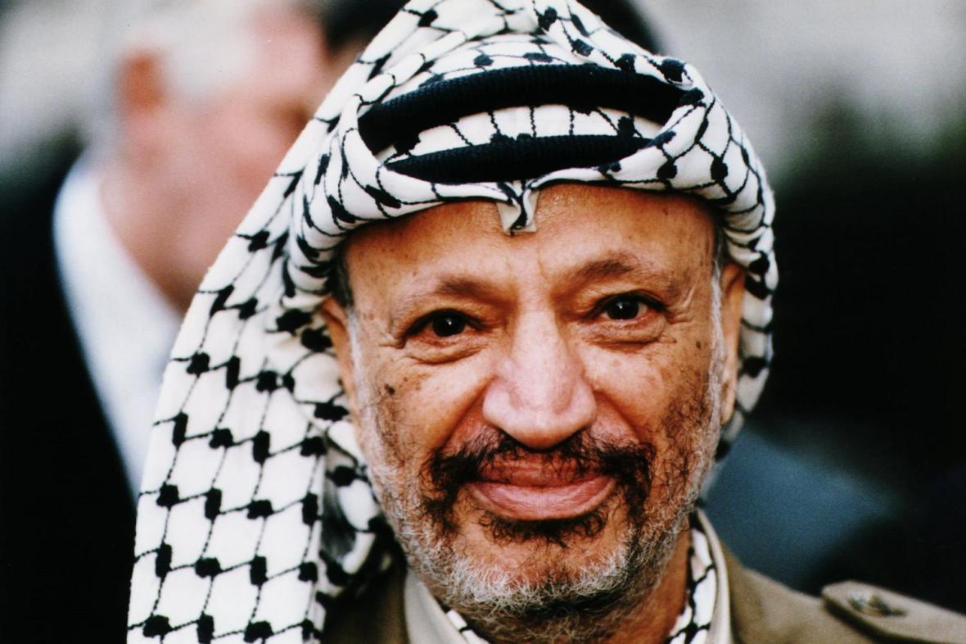
How did Palestinian nationalism change in the 1960s and 1970s?
Lesson 10

Slide 2
Learning objectives
By the end of this lesson, you should be able to:
Identify the impact of the June 1967 War on Palestinian nationalism
Describe the Palestinian national movement in the 1960s and 1970s
Explain the differences among Palestinian nationalists at this time

Slide 3
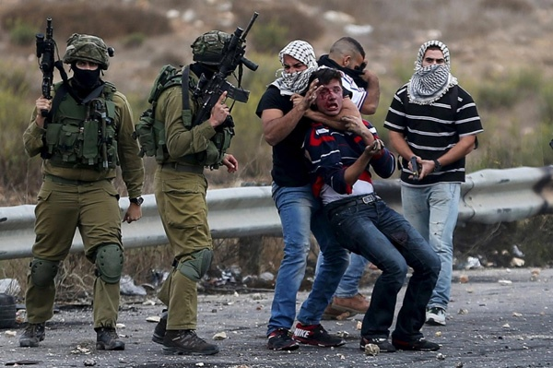
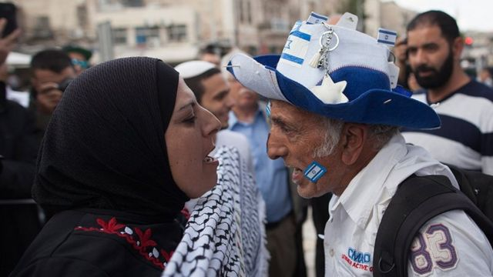
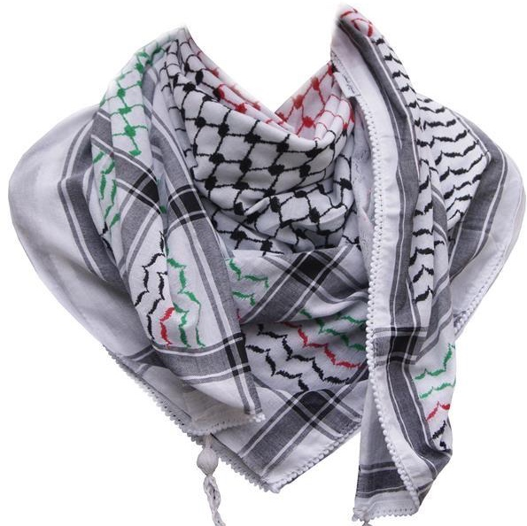
Answer this question with the person next to you:
What comes to mind when you see this scarf (the keffiyeh)?
Violence?
Resistance to oppression?
Liberation?

Slide 4
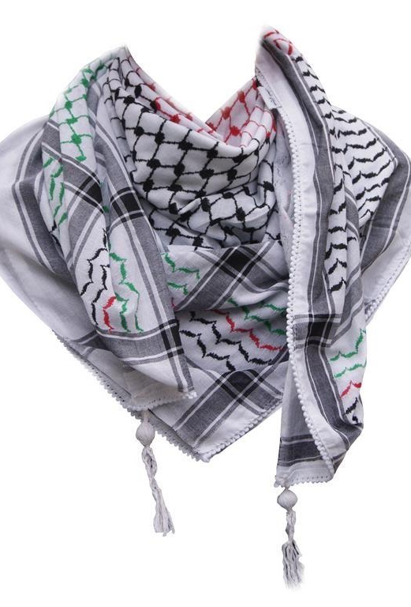
The keffiyeh
A traditional Middle Eastern headdress because it protects from the sun and the sand
Became a symbol of Palestinian nationalism during the Arab Revolt of 1936-1939
Can you remember what this revolt was?
  a nationalist uprising by Palestinian Arabs against the British administration of the Palestine Mandate
The keffiyeh became very popular in the 1960s and was worn by Yasser Arafat (who we’ll look at today)
It is an important symbol of Palestinian nationalism

Slide 5
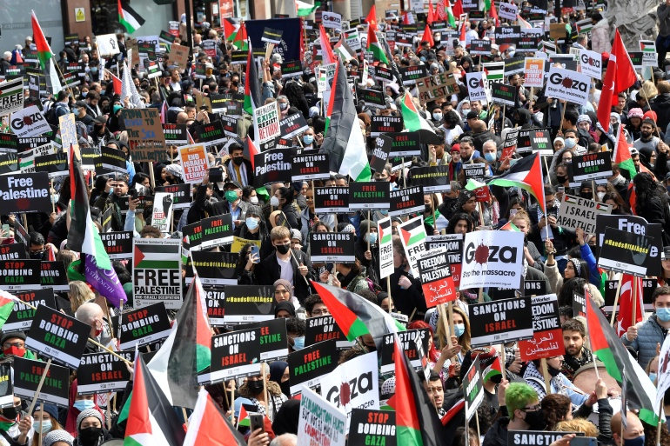
In May 2021, demonstrations for Palestine took place across the UK.
180,000 individuals gathered in London
How many keffiyehs can you spot in this photo?

Slide 6
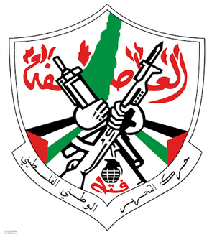
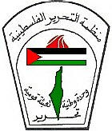
Can you guess some of today’s keywords using these images?
Fatah
Yasser Arafat
keffiyeh
Palestine Liberation Organisation (PLO)

Slide 7
Today’s keywords
Add these to your glossary
keffiyeh: a black and white headdress which has become an important symbol of Palestinian nationalism
Yasser Arafat: a significant Palestinian leader and founding member of Fatah
Fatah: a Palestinian nationalist group founded by Yasser Arafat in 1959. It remains one of the most popular Palestinian political parties today
Popular Front for the Liberation of Palestine (PFLP): a Palestinian nationalist group founded by George Habash in 1967. Aimed to establish a Marxist state in Palestine
Palestine Liberation Organisation (PLO): an umbrella organisation of Palestinian nationalist groups. Widely recognised as representative of the Palestinian people. Has had observer status at the UN since 1974
Munich Olympics Massacre, 1972: when members of the Black September group massacred nine Israeli athletes in September 1972
observer status at the UN: the ability to participate in UN activities, but not to vote

Slide 8
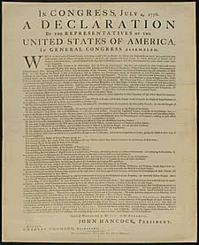
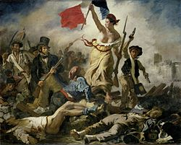
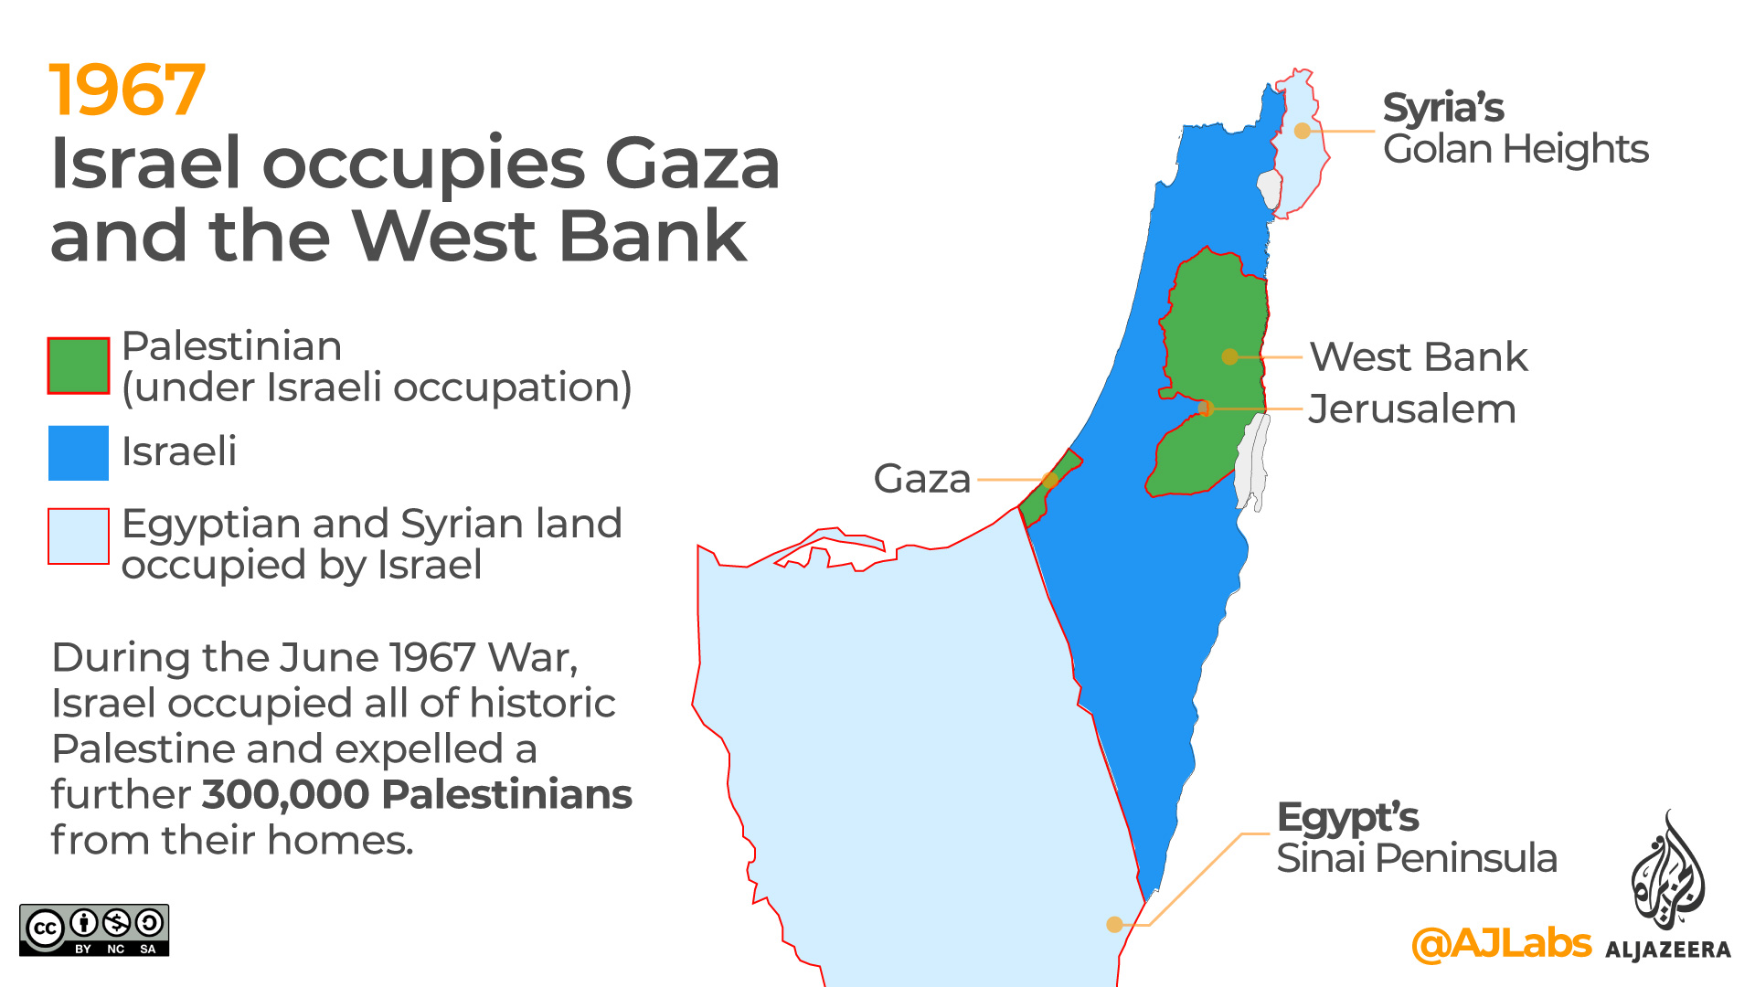
Recap
Extension question: why might the geographic division of Palestinians be problematic for the nationalist movement?
In small groups, answer these questions:
1) What is nationalism? What are some examples? (You can use your notes from Lesson 3)
2) What is Palestinian nationalism?
3) Where did Palestinians live after the Nakba of 1948 and Naksa of 1967?
Nationalism: the belief that one's country or state is distinct from and superior to others, and that it should govern itself
1800s: American Declaration of Independence (1776), French Revolution (1789), emergence of Zionism
1900s: WWI, Arab Revolt of 1936-1939, Nazi Germany, India, Nasser & Arab nationalism
The movement of Palestinians to establish a Palestinian state
Broke away from Arab nationalism in the early 1900s, partly due to the threat of Zionism
Demonstrated in the Arab Revolt of 1936-1939
1. Within the new state of Israel, as second-class citizens
3. In Gaza, under Egyptian control
4. In big tented refugee camps run by UNRWA in Jordan, Lebanon and Syria
2. In the West Bank, under Jordanian control

Slide 9
The impact of June 1967 on Palestinian nationalism
With the person next to you:
What happened in June 1967? What were the consequences?
  Over 6 days in June 1967, Israel defeated Egypt, Jordan and Syria
  By occupying the West Bank, Gaza, East Jerusalem, the Golan Heights and the Sinai Peninsula, the territory under Israel’s control quadrupled (4x)
Witnessing this defeat of their Arab neighbours, Palestinians realised that they needed to strengthen their own national movement against Israeli aggression
However, the Palestinians were geographically divided at this time
This meant that the Palestinian nationalist movement was divided too
We are going to look at this today
Imagine you were Palestinian in 1967. How would you feel?

Slide 10
Now we are going to look at Palestinian nationalism in more detail
It would be helpful to make a note of these acronyms at the top of your page:
PLO: Palestine Liberation Organisation
PFLP: Popular Front for the Liberation of Palestine

Slide 11
10a. Use the cards below to create a brief timeline in your book of the key events in Palestinian nationalism between 1959 and 1972:
October 1959: Fatah is established by Yasser Arafat
1964: Nasser convenes the first Arab summit in Cairo and the PLO is established
September 1970: PFLP hijacks and blows up three planes (without passengers)
1967: Fatah joins the PLO
September 1972: nine Israeli athletes are massacred by the Black September group at the Munich Olympics
1967: George Habash establishes PFLP
March 1968: The Battle of Karameh increases Yasser Arafat and Fatah’s popularity among Palestinians

Slide 12
Fatah
Movement started among Palestinians in refugee camps in Egyptian-controlled Gaza in 1950s. Why was Gaza controlled by Egypt at this time?
Inspired by the Algerian liberation movement
Main founder was Yasser Arafat (pictured), alongside other Palestinians who had attended university in Cairo, Egypt or Damascus, Syria
Formally established during a series of meetings in Kuwait in 1959
Became very popular among Palestinian refugees in refugee camps and urban centres (eg. Amman, Jordan and Damascus)
Specifically about Palestinian nationalism (not Arab nationalism)
A non-religious, secular movement (advocated the separation of state and religion)
Strategy: armed struggle especially guerrilla warfare to pressure Israel into leaving the occupied territories
  Guerrilla warfare: when small groups use military tactics (eg. raids/ambushes) to fight a larger military (eg. Israel)
Fatah’s popularity was boosted by the Battle of Karameh in March 1968, which was the Palestinians first victory over Israel on their own (without help from Arab states)
Still one of the most popular Palestinian political parties in 2021

Slide 13

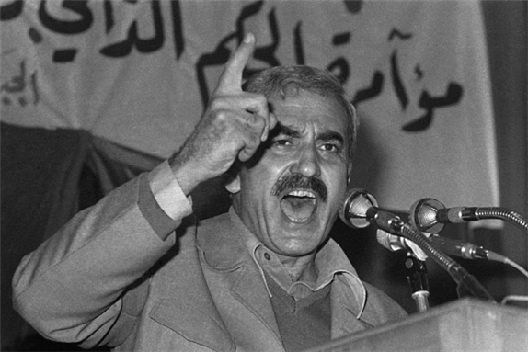
PFLP
PFLP: Popular Front for the Liberation of Palestine
After Fatah, this was the next biggest Palestinian nationalist group in the 1960s and 1970s
Founded by Palestinian Christian George Habash (pictured) in 1967
Inspired by Latin American revolutionary ideology, especially Che Guevara
Habash had previously founded the Arab Nationalist Movement (ANM) in 1951, but in 1967 he focused on a more specifically Palestinian nationalism
Similar to Fatah, PFLP was a non-religious, secular group
Eventually wanted to establish a Marxist state in Palestine
Strategy: armed struggle, especially attacks outside Israel to bring global attention to the Palestine crisis
  In 1969, PFLP hijacked three planes and blew them up (without passengers) in the Jordanian desert
  In September 1970, PFLP hijacked four planes and blew three of them up (without passengers) at Dawson’s Field in Jordan

Slide 14
PLO
PLO: Palestine Liberation Organisation
Although Fatah was established in 1959, in the early 1960s there was still no recognised representative Palestinian body
To address this, Gamal Abdel Nasser of Egypt convened the first Arab summit in 1964 in Cairo. The aim was to establish a recognised representative Palestinian body
It was difficult to organise this, given the geographic dispersal of Palestinians at this time
Eventually, the PLO was established as a recognised representative body of the Palestinian people, with the motto ‘National Unity, Arab National Mobilisation, and Liberation’
The aim of the PLO was to establish a Palestinian state across the whole of Mandate Palestine
Strategy: armed struggle to achieve the liberation of Palestine from Israeli aggression
Rather than thinking of the PLO as a rival to Fatah or PFLP, it’s best to think of PLO as an umbrella organisation (Fatah joined the PLO in 1967, and has mostly been the dominant party of the PLO ever since)
Since 1964, the PLO has been widely recognised as representative of the Palestinian people. It has had observer status at the UN since 1974
observer status at the UN: the ability to participate in UN activities, but not to vote

Slide 15
10b. Use this information to complete this table on Palestinian nationalism in the 1960s and 1970s in your book:
Palestinian organisation: | Origins and year of establishment: | Important individuals: | Type of nationalism: | Strategy:
Fatah
PFLP

Slide 16
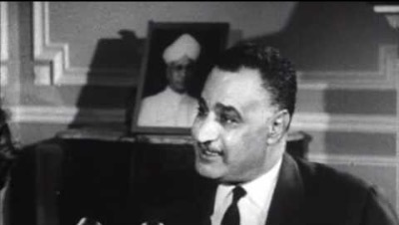
Watch 05:09 to 09:28 and add any extra information to your table
https://www.youtube.com/watch?v=aGC_hHii1jo&feature=emb_logo

Slide 17
10b. Use this information to complete this table on Palestinian nationalism in the 1960s and 1970s in your book:
Palestinian organisation: | Origins and year of establishment: | Important individuals: | Type of nationalism: | Strategy:
Fatah | Originated in refugee camps in Egyptian-controlled Gaza in the 1950s. Inspired by the Algerian liberation movement. Officially founded in Kuwait in 1959 | Yasser Arafat | Palestinian nationalism (not Arab nationalism). Secular, so non-religious | Armed struggle. Guerrilla warfare to pressure Israel into leaving the occupied territories
PFLP | Palestinian Christian founder of PFLP George Habash had previously led the Arab Nationalist Movement, but in 1967 he focused on a more specific Palestinian nationalism and founded PFLP | George Habash (inspired by Che Guevara) | Palestinian nationalism (not Arab nationalism - Habash moved away from the Arab Nationalist Movement and towards PFLP). Also secular, so non-religious | Armed struggle, especially attacks outside Israel to bring global attention to the Palestine situation, for example hijacking planes and blowing them up

Slide 18
With the person next to you, use your completed table to answer these questions
What was the difference between Fatah and PFLP?
Would you have supported either group if you were Palestinian in the 1960s and 1970s?
Now join up with another pair and share your answers

Slide 19
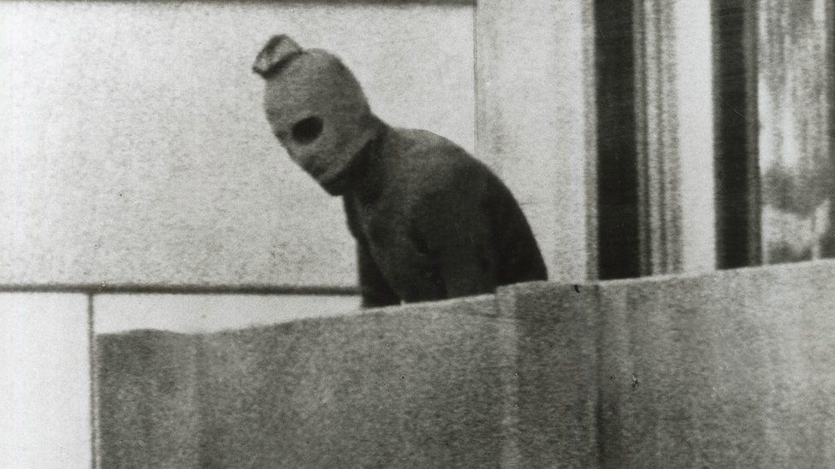
The PLO, Jordan and Black September
After 1967, the PLO and Fatah launched attacks on Israel from Jordan
This meant that when Israel retaliated, Jordan was affected
King Hussein of Jordan was also concerned because half of the Jordanian population were Palestinian refugees and this threatened his leadership!
In 1970, King Hussein expelled the PLO from Jordan and fighting ensued. This is known as Black September
The PLO had to move to Lebanon
As a result of this expulsion from Jordan, a group called Black September emerged
  In 1971, this group assassinated the Jordanian Prime Minister
  In 1972, they massacred nine Israeli athletes at the Munich Olympics
Why was King Hussein of Jordan worried about the PLO in 1970?

Slide 20
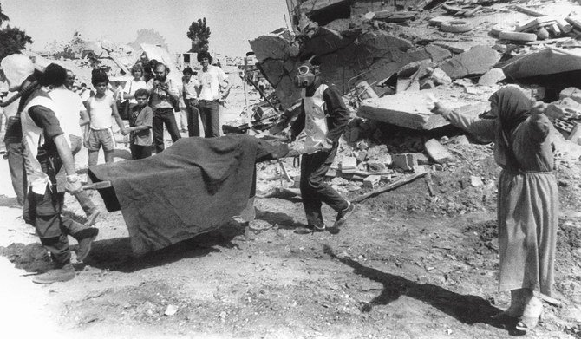
1982 Lebanon War
Having moved to Lebanon in 1970, the PLO launched attacks from Lebanon into Israel
After an assassination attempt by Palestinian nationalists on Shlomo Argov (Israel’s ambassador to the UK), the IDF invaded south Lebanon on 6th June 1982
By August, Lebanese leaders had had enough: they ordered the PLO and Palestinian fighters to leave
The PLO leadership and many fighters went to Tunisia, Syria and further afield
It was in this context that the Sabra and Shatila massacres occurred
  Between 16th and 18th September 1982, Lebanese Christian militias entered the now unprotected refugee camps of Sabra and Shatila and massacred between 460 and 3,500 individuals, mostly Palestinians
  The IDF did not intervene to stop the massacre
Israel Defense Forces
__________________
the military of the state of Israel
What was the IDF?

Slide 21
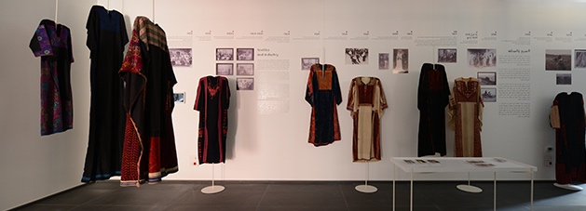
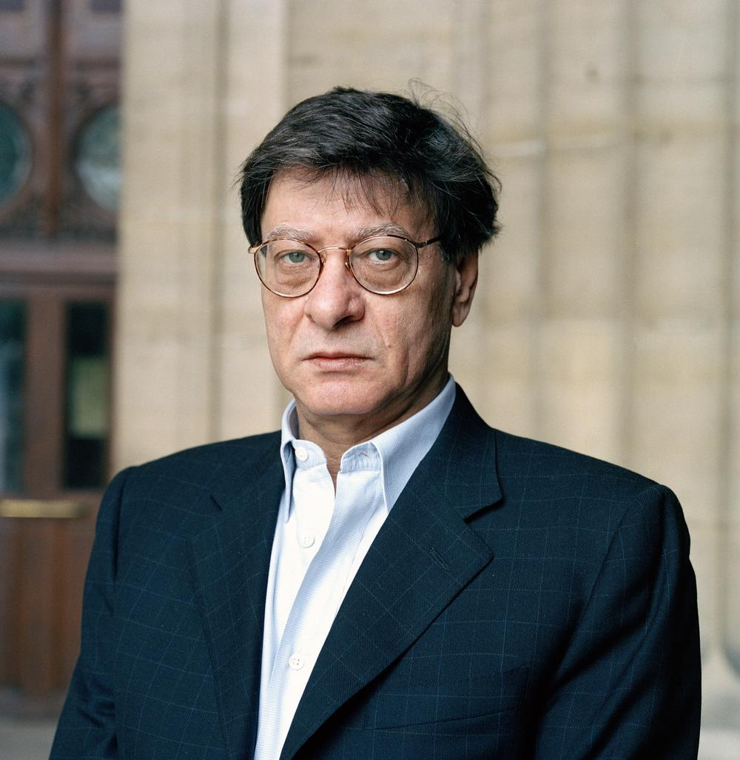
Palestinian identity has been strengthened in many ways since the 1948, including embroidery and poetry

Slide 22
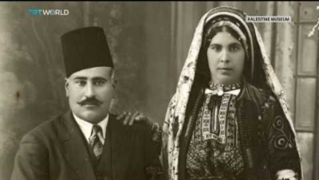
At the Seams:
A Political History of Palestinian Embroidery
Watch this video and answer this question in your books:
Why was (and is) Palestinian embroidery important?

Slide 23
Homework
These are extracts from ‘ID Card’ by Palestinian poet Mahmoud Darwish in 1964.
Spend some time researching Mahmoud Darwish and answer these questions:
What feelings are being expressed in this poem?
What is the message of the poem?
Why did Darwish write this?
Write down:
I am an Arab.
My ID card number is 50,000.
XXX
Write down:
I am an Arab
Robbed of my ancestors’ vineyards
And of the land cultivated
By me and all my children.
Nothing is left for us and my grandchildren
Except these rocks…
Will your government take them too, as reported?
Therefore,
Write at the top of page one:
I do not hate people,
I do not assault anyone,
But…if I get hungry,
I eat the flesh of my usurper.
Beware…beware…of my hunger,
And of my anger.
XXX
Write down:
I am an Arab.
Hair coal-black,
Eyes brown,
My distinguishing feature:
On my head a koufiyah topped by the igal,
And my palms, rough as stone,
Scratch anyone who touches them.
My address:
An unarmed village—forgotten—
Whose streets are nameless,
And all its men are in the field and quarry.
Are you angry?

Slide 24
Plenary
1) What was the impact of the June 1967 War on Palestinian nationalism?
2) What did the following groups want, and what was their strategy to achieve it?
  Fatah
  PFLP
  PLO

